Slide 1
Case Study on Airlines Analysis
Batch: BI V7 with MS Azure PT Sep 6th Batch1
Group Members:
Harshit Mudgal
Abhaya Shankar
Armaandeep Sandhu
Ashitosh Joshi
Abhishek Baghel
Presentation Date: 20th October 2022

Slide 2
Problem Statement
To create an end to end flow for deployment of Tabular model in the SQL Server Analysis Services (SSAS).
Tasks to be performed:
Load the dataset in SQL DB
Load that data into the Analysis Services Tabular model project from SQL DB
Clean the dataset
Create relationship between tables
Create required measures/calculated columns
Deploy the tabular model in SQL SSAS
Get possible insights of data

Slide 3
Prerequisites
SQL Server 2017 (or higher) with SQL Server Analysis Services Implemented
Visual Studio 2017 (or higher) with Tabular Project Template
Power BI Desktop to create Visualizations
SQL Server Management Studio to Load and Deploy the model

Slide 4
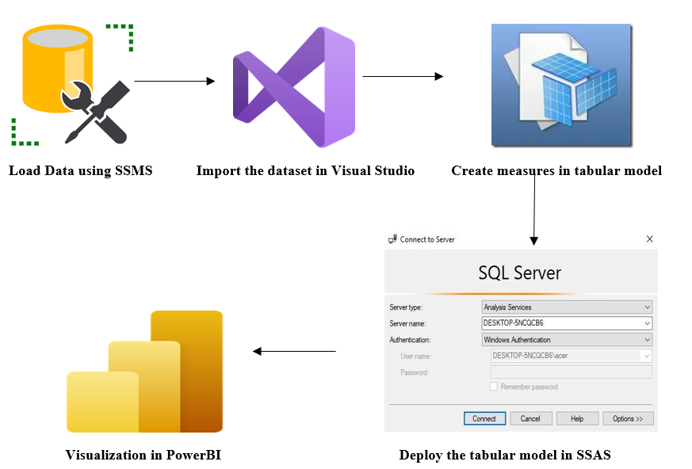
Project Design

Slide 5
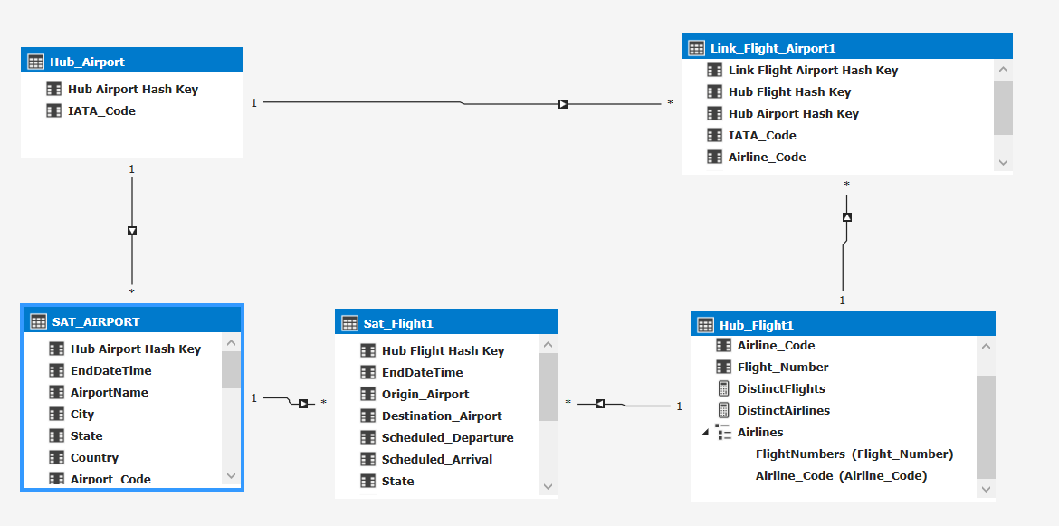
Diagram View of Tabular Model

Slide 6
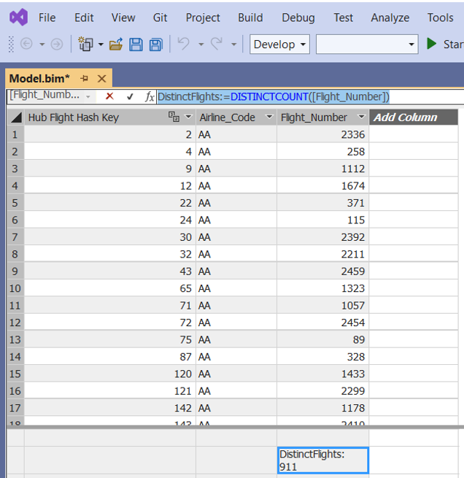
Sample DAX Query
Total No. of different flights running
DistinctFlights:=DISTINCTCOUNT([Flight_Number])

Slide 7
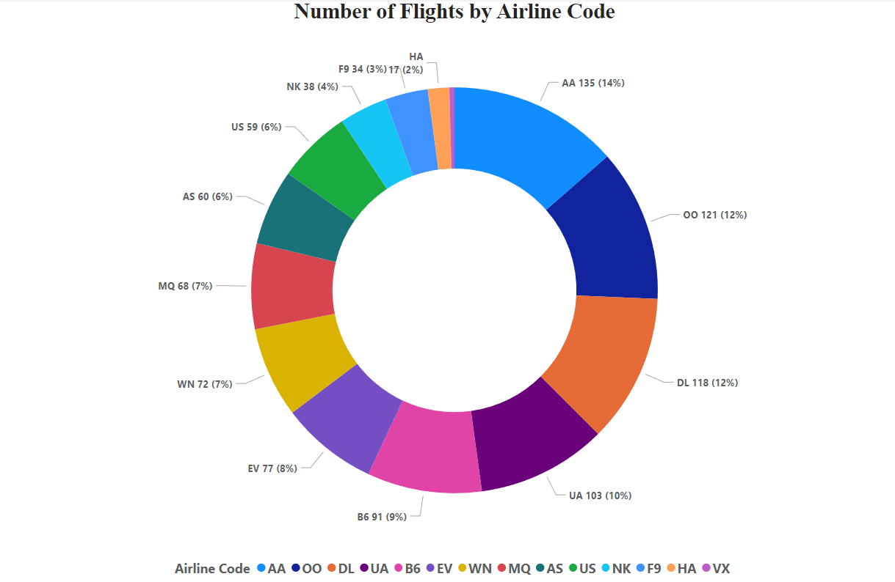
Sample Visualization
Airline-wise number of flights running

